Slide 1
🛡️
Q-Shield Agent
AI-Powered Post-Quantum Cryptography Security Assessment
Automated detection of quantum-vulnerable cryptography with NIST-backed guidance, LLM-driven reporting, built-in AI guardrails, and CI/CD-native PR integration.
CBOM Analysis
RAG + LLM
AI Guardrails
GitHub Actions
NIST Compliant
TEAM 1 | THEME: SECURITY REASONING AGENT
Megha Narendra Simha · Sai Shruthi Sridhar · Poorrnima Palanisamy Vetrivelan

Slide 2
The Problem
Quantum computers will break widely-used cryptography. Most organizations aren't ready — and don't even know what's at risk.
⚛️
🔍
📋
Quantum Breaks Crypto
No Visibility
Complex Migration
Shor's algorithm will break RSA, ECDSA, and Diffie-Hellman. “Harvest now, decrypt later” attacks are already happening today.
Teams don't know which algorithms are embedded in their codebases. Manual audits are slow, incomplete, and don't scale across repositories.
NIST has published PQC standards (FIPS 203, 204) but translating them into prioritized engineering plans requires deep expertise most teams lack.

Slide 3
Target Users
Built for security and engineering teams responsible for cryptographic risk management.
🔒
👩‍💻
🏛️
Application Security Engineers
Development Teams
Governance & Compliance Officers
Inventory cryptographic assets
Assess PQC readiness
Produce governance evidence for compliance
Clear, actionable migration recommendations
Integrated into existing CI/CD workflow
No context switching required
Executive-level quantum readiness scores
Risk prioritization by wave
NIST-referenced audit artifacts

Slide 4
Solution
End-to-end automated quantum security assessment — from code to compliance.
🔬
⚠️
📚
Scan
Detect
Retrieve
Automatically inventories cryptographic assets from CBOM and SonarQube
Identifies quantum-vulnerable algorithms like RSA, SHA-1, MD5, AES-128
RAG knowledge base built from NIST FIPS 203, 204, and SP 1800-38B
🤖
🗺️
📋
Assess
Prioritize
Deliver
AI agent generates contextual security assessments grounded in evidence
Migration recommendations, remediation plans, and quantum readiness scores
Enterprise-ready reports validated by guardrails, posted directly to PR
Automated, evidence-based quantum security assessments — delivered in your pull request.

Slide 5
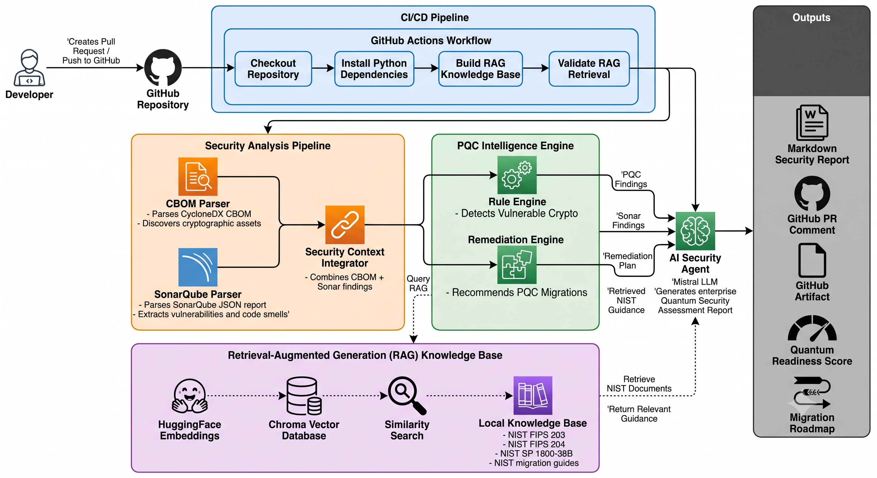
Data Flow & Architecture
Every step is automated in CI — triggered on every pull request.
Steps 2–5 run as GitHub Actions jobs; step 6 is a required status check that blocks merge below the readiness threshold.

Slide 6
Trust & Safety Features
AI guardrails ensure the generated report is accurate, safe, and structurally complete.
🛡️ Prompt Injection Protection
🔬 Hallucination Detection
📋 Output Validation
Scans all inputs (RAG docs, SonarQube data, CBOM) before they reach the LLM.
Verifies every claim in the report against source evidence — nothing is taken on faith.
Ensures the report meets structural requirements and contains no fabricated content.
Instruction override detection
Role manipulation patterns
Data exfiltration attempts
Delimiter injection attacks
Auto-sanitization of threats
Algorithm existence vs CBOM
NIST reference verification
File path & line cross-check
Risk level consistency
Finding ID validation
Required section presence
Fabricated reference detection
LLM refusal pattern detection
Finding coverage completeness
Score range validation

Slide 7
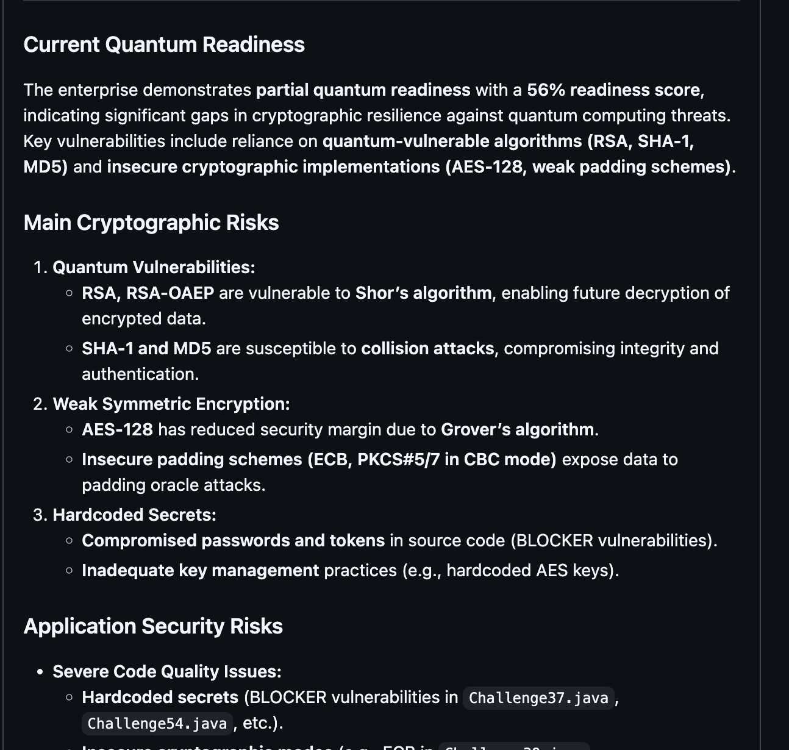
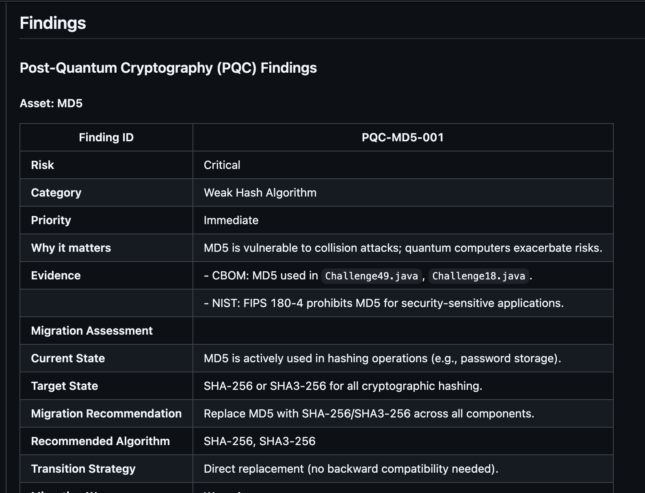
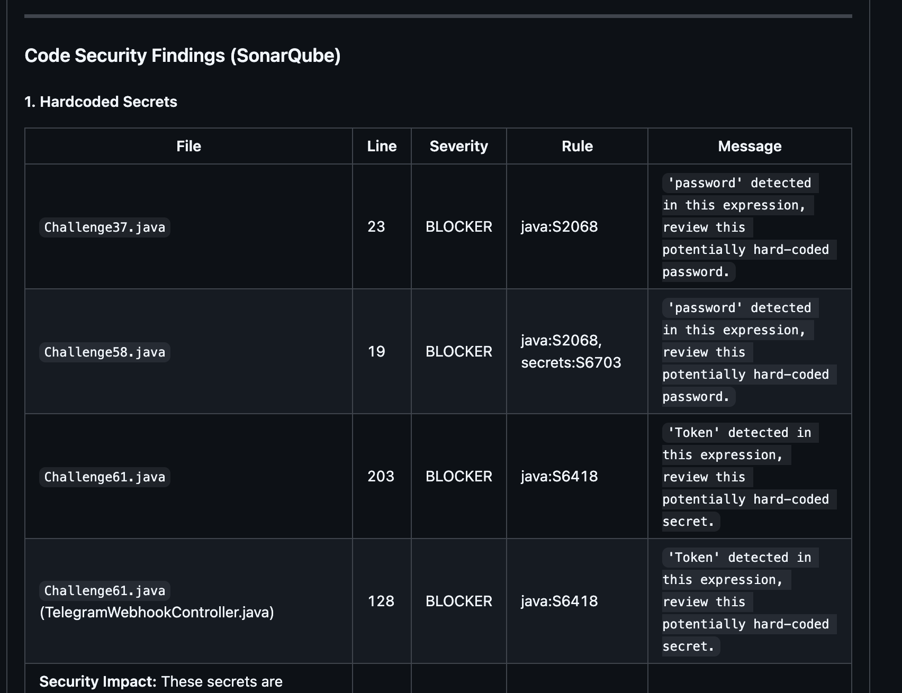
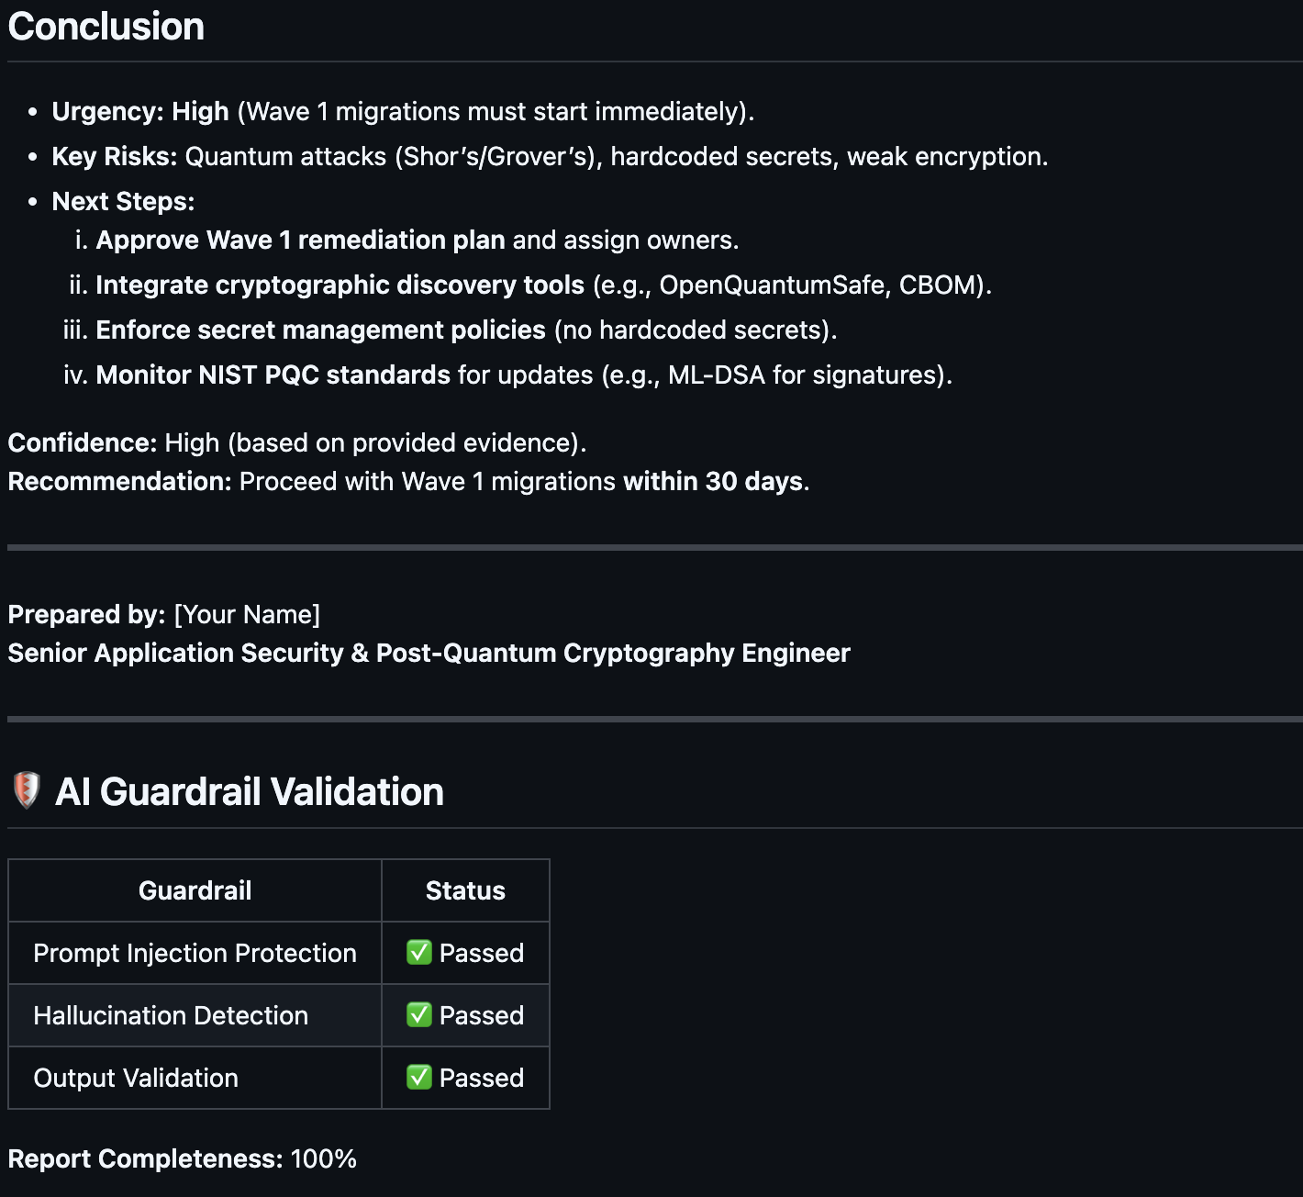
Practical Result

Slide 8
Anticipated Questions
Addressing key questions about Q-Shield Agent's value and differentiation.
❓ When we already have a GitHub workflow, what is the use of the agent?
The workflow is infrastructure; the agent is intelligence.
Workflow orchestrates steps — cannot reason or correlate
Agent synthesizes findings into actionable narrative
Self-validates output through guardrails
❓ Won't GitHub Copilot do the same thing?
Copilot is a generalist with no access to your security context.
No CBOM, SonarQube, or PQC rule ingestion
No RAG retrieval from NIST standards
Cannot produce governance artifacts (scores, waves, compliance)
❓ Is the agent taking action or just giving recommendations?
It enforces — blocks PR merges when readiness score is below threshold.
Security gate is a concrete enforcement action
Outputs structured recommendations (algorithms, effort, owners)
Auto-patching excluded — crypto migration requires human judgment

Slide 9
Key Limitations
What Q-Shield Agent does not cover — important for honest assessment.
⚠️
CBOM Completeness
🤖
LLM Accuracy
The agent only sees cryptographic assets present in the CBOM input. If the CBOM scanner misses a dependency, Q-Shield won't detect it.
Despite guardrails, LLM outputs may still contain imprecise language. Guardrails catch structural issues — not subtle semantic errors.
🔌
External API Dependency
📦
No Auto-Remediation
Report generation requires Mistral API access. If the API is unavailable or rate-limited, the pipeline step will fail.
Q-Shield recommends fixes but does not automatically apply code changes. Engineers must implement the migration manually.
🧪
Static Analysis Scope
📚
Knowledge Base Currency
Cryptographic usage detected at build/config time only. Runtime-negotiated algorithms (TLS handshakes, dynamic key selection) are not covered.
RAG knowledge is limited to the NIST PDFs in the repository. New NIST publications require manual ingestion to update guidance.

